Slide 1
De-escalation Training
Sgt. Michael Shaffer
Sgt. Grimaldi
August 12, 2020
August 15, 2020

Slide 2
Disclaimer
Always follow our policies and procedures
Never compromise officer safety
Remember: some situations do not lend themselves to de-escalation.
De-escalation Training 2020

Slide 3
Course Goals
Define De-escalation
Provide Historical Context
Discuss Techniques, Strategies, and Tactics
Review Tactical Positioning and Verbal control
Review FCPD Policy
Review relevant legal issues
De-escalation Training 2020

Slide 4
What is De-escalation?
Bodycam Shows K9 Deputy Successfully Talks Down Armed Subject
De-escalation Training 2020
Notes:
Bodycam Shows K9 Deputy Successfully Talks Down Armed Suspect

Slide 5
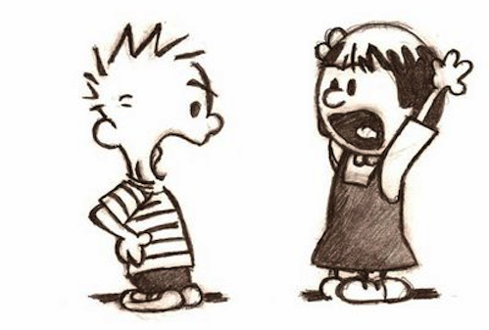
What is De-escalation?
Behavior intended to escape escalations of conflict
A combination of communication, empathy, instinct, and sound officer safety tactics
De-escalation can reduce conflict before it develops
De-escalate [ dee-es-kə-leyt ]: reduce the intensity of (a conflict or potentially violent situation).
De-escalation Training 2020

Slide 6
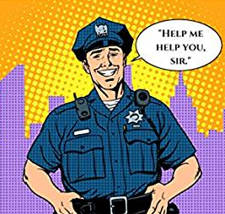
What is De-escalation?
Above all:
De-escalation is a philosophy and not a specific process or tactic
De-escalation Training 2020

Slide 7
What is De-escalation?
Kevin Dillon: De-escalation Tactics
De-escalation Training 2020
Notes:
Kevin Dillon: De-escalation tactics

Slide 8
Benefits of De-Escalation
What is in it for you?
Fewer officer injuries
Fewer citizen injuries
Quicker resolutions
Reduced liability for officers and the agency
Reduced stress/ health problems for officers
Better community relations
Better media coverage
Reduced liability for officers and the agency Reduced investigations and less paperwork for officers
De-escalation Training 2020

Slide 9
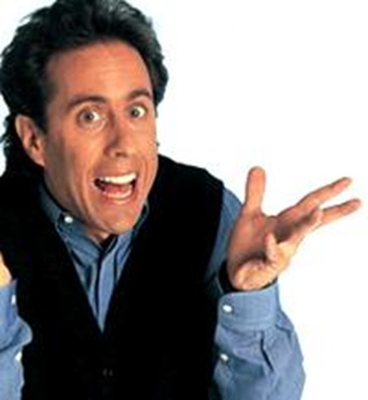
What is Our Mission?
De-escalation Training 2020
Notes:
Chalk board exercise – group question

Slide 10
De-escalation Origins
De-escalation is not a new concept. Police have been using de-escalation techniques since the beginning of policing.
George “Doc” Thompson, PhD is known as the father of tactical communication. He published his first book on Verbal Judo for Police in 1983.
“I simply used my academic background to put words to what great cops have always done.”
- George “Doc” Thompson
De-escalation Training 2020

Slide 11
Module 2 – De-escalation Techniques and Strategies
De-escalation Training 2020

Slide 12
De-Escalation Starts with You
De-escalation skill starts with self-awareness:
Self care
Physical fitness/Healthy lifestyle
Can affect confidence levels
Are you stressed? How does this stress affect you at work?
Your stress reaction can greatly affect the outcome of your interaction with the other person.
De-escalation Training 2020

Slide 13
Strategy: Crisis vs. Problem
Problems:
Lack urgency
Have time
Maybe do not need intervention
Crisis:
Must be acted on immediately
Ex: an occupied house is on fire; active shooter
A Matter of Perspective: Just ask yourself, “Is this a crisis or just a problem?”
De-escalation Training 2020
Notes:
Great listening skills are important in life and may save your life in law enforcement. Active listening skills are the foundation of de-escalation.
In this section we will present some specific listening and response techniques for de-escalating situations involving individuals in crisis or emotionally disturbed persons:
Active Listening is a way of listening and responding to another person that improves mutual understanding. Often when people talk to each other, they don’t listen attentively. They are often distracted, half listening, half thinking about something else.
Encouraging/reassuring means being sympathetic and reassuring to the speaker and communicating one’s support for the speaker. You may not agree with the subject, but are being encouraging to the speaker.
Paraphrasing is restating what is said to ensure you understand. A restatement does not have to be using the same words, only expressing the same meaning of what was originally stated. A paraphrase often clarifies the original statement by putting it into words that are more easily understood.
Summarizing is when the general idea or the most important point is presented. It helps to organize and give credence to the conversation. It's a skill we use every day in a patrol environment or a meeting with a supervisor.

Slide 14
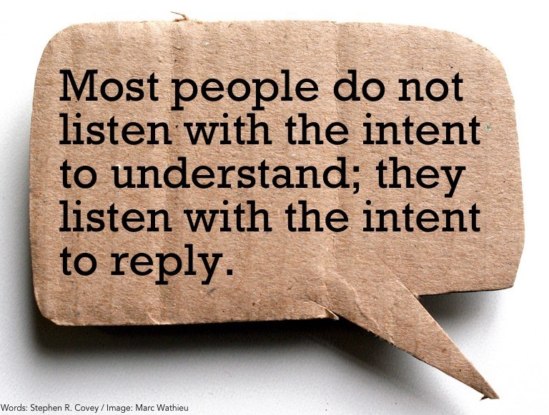
Technique: Active Listening
Active listening skills are the foundation of de-escalation
De-escalation Training 2020
Notes:
Great listening skills are important in life and may save your life in law enforcement. Active listening skills are the foundation of de-escalation.
In this section we will present some specific listening and response techniques for de-escalating situations involving individuals in crisis or emotionally disturbed persons:
Active Listening is a way of listening and responding to another person that improves mutual understanding. Often when people talk to each other, they don’t listen attentively. They are often distracted, half listening, half thinking about something else.
Encouraging/reassuring means being sympathetic and reassuring to the speaker and communicating one’s support for the speaker. You may not agree with the subject, but are being encouraging to the speaker.
Paraphrasing is restating what is said to ensure you understand. A restatement does not have to be using the same words, only expressing the same meaning of what was originally stated. A paraphrase often clarifies the original statement by putting it into words that are more easily understood.
Summarizing is when the general idea or the most important point is presented. It helps to organize and give credence to the conversation. It's a skill we use every day in a patrol environment or a meeting with a supervisor.

Slide 15
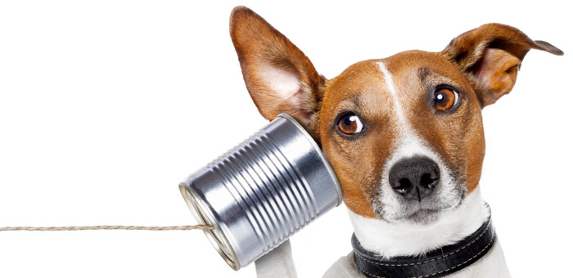
Technique: Active Listening
Employing active listening techniques :
Enables you to understand how the citizen feels and how he or she views the situation.
Shows that you care and that you feel that what’s being said is important.
De-escalation Training 2020
Notes:
Employing active listening techniques enables you to understand how the citizen feels, and view the situation as they do. It also shows that you care and that you feel that what’s being said is important.
We often pretend to listen, because it is human nature; yet real listening takes effort and thought. It involves active participation, listening to not only what is said, but how it is said. Active listening involves recognizing that the tone of voice used or non-verbal clues may indicate true feelings. Sometimes simply being quiet will not do, and active listening is required.
Active listening is a way of listening and responding to another person that improves mutual understanding. Often when people talk to each other, they don’t listen attentively. They are often distracted, half listening, half thinking about something else. Active listening techniques include:
Engaging the other person in discussing their feelings.
Listening to the person without judging.
Paying close attention to what the person says.
Reflecting or restating what the person has said.
Asking clarifying questions to show that you want to understand.
Maintaining comfortable eye contact.
Using minimal prompts, such as “I see” and “ah”.
Being patient and not interrupting. It is important to be patient, even when the person may not be communicating well, is repetitive, or is speaking more slowly and less clearly than usual.
Allowing silences.
When employing Active Listening:
Maintain an open body position.
Do not be critical.
Do not express frustration at the youth.
Do not give flippant or unhelpful advice such as “stay out of trouble.”
Avoid confrontation unless necessary to prevent harmful or dangerous acts.

Slide 16
Technique: Encouraging/Reassuring
Use noncommittal words and a positive tone
Ask open-ended questions
Encourage individual to seek out social programs/mentorship programs
Offer to assist in finding help
De-escalation Training 2020
Notes:
The technique of encouraging/reassuring means being sympathetic and reassuring to the speaker. It involves the use of noncommittal words and a positive tone of voice. This puts the person more at ease so that he doesn’t immediately feel on the defensive. If an officer rules the encounter by threat and intimidation, the person may rebel and fight back, which will just feed into the negative image of authority that some individuals have. You don’t have to agree with the subject to be sympathetic and encouraging to him.
Asking open-ended questions forces the person to explain or to expand on an answer. An open-ended question – which is not always a true question, but rather a statement which asks for a response - is designed to encourage the individual to provide a full answer rather than a one- or two-word response. Examples of open-ended questions are:
“Tell me more about that.”
“Help me to understand.”
“Teach me.”
Many times people in crisis do not realize that there are support organizations available to help them. Thus another aspect of this response is to encourage appropriate help, if needed. You can offer to help them seek out options, and encourage them not to give up on finding appropriate help if they need it.

Slide 17
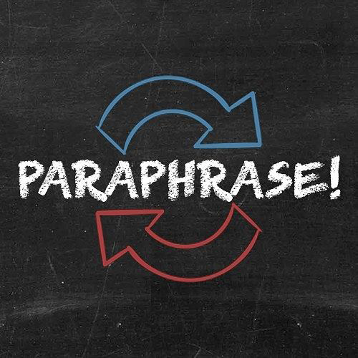
Technique: Paraphrasing
Emphasizes what's important to the subject
Allows for clarification
Shows that you are listening
Builds trust and rapport
Forces the subject to listen
De-escalation Training 2020
Notes:
The de-escalation technique of paraphrasing means restating what is said to ensure that you understand. It involves giving the other person back your understanding of what he is saying. It emphasizes what is important to him. It allows for clarification, and shows that you are listening.
Paraphrasing builds trust and rapport. In paraphrasing, you restate the basic issue in your own words, not simply repeating his. If you "parrot" what he has said, it may seem as though you are humoring, pacifying, or manipulating him.
Paraphrasing forces the other person to listen. Hearing the issue voiced aloud by someone else may give him a different view of his own thoughts.

Slide 18
Technique: Empathetic Listening
Do NOT be judgmental.
Do NOT ignore the person or pretend to be paying attention.
Listen to what the person is really saying.
Re-state the message.
Clarify the message.
Repeat the message.
Be empathetic!
Validate -- “I understand why…”
Try to establish rapport with the other person.
De-escalation Training 2020

Slide 19
Video Discussion: Communication
Disturbing Video Shows Unarmed Man Begging Before Fatal Police Shooting
De-escalation Training 2019

Slide 20
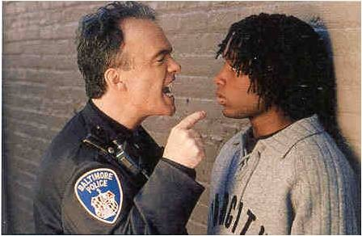
Module 3 – Communication Tactics
De-escalation Training 2020

Slide 21
Elements of Verbal Communication
Be clear and accurate
Avoid jargon or slang
Be aware of both surface and hidden meanings
Avoid satire, sarcasm, and jokes
Use words that can be understood
De-escalation Training 2020

Slide 22
Voice Control and Respect
Lowered voice level may set a tone of anger
Raised voice may set a tone of anticipation or uncertainty
Controlled voice promotes confidence in both parties
Speaking slowly is usually interpreted as soothing
De-escalation Training 2020
Notes:
Voice control may be the single most important aspect of verbal communication. All too often officers are taught that a loud and commanding voice is necessary, but in many routine situations, the opposite is true.
A lowered voice level may set a tone of anger, which could create fear or challenges.
A raised voice may set a tone of anticipation or uncertainty, which may promote excitement or disruption. It may also escalate the situation, so make sure you control your voice.
A controlled voice is one of calm and firmness, which promotes confidence in both parties.
Speak slowly; this is usually interpreted as soothing.
Respect for all involved parties is tremendously important. Here are some guidelines to ensure a respectful discussion and assist in de-escalating a potentially violent encounter:
Always be respectful to the other person.
Using “please” and “thank-you”; “Mr.” or “Ms.” indicates respect.
Humor may unintentionally offend someone and escalate the situation. Use humor sparingly, and always direct humor toward yourself. (Be very careful when attempting humor in this type of situation!)
Use a first name approach if possible, but always treat individuals with respect.

Slide 23
Other Techniques
Offer undivided attention | Give helpful choices
Be nonjudgmental | Distract the other person
Focus on feelings | Motivate the other person
Allow silence | Set limits
Clarify messages
De-escalation Training 2020
Notes:
Offer Undivided Attention When people are paid attention to they feel validated; they feel important. The converse is also true: people feel less important and sometimes feel they need to “up the ante” if they feel like they need attention. Paying attention doesn't just mean saying, "I'm listening." It means looking at the person, making eye contact if it's culturally appropriate, and basically listening with the entire body. By really listening, and conveying that through body language as well as words, an officer can take away the person's reason for escalating the situation. Be Nonjudgmental If someone says, "The sewers are talking to me," an officer's immediate reaction might be to think that the person is crazy. That reaction--especially if verbalized--will probably upset the individual even more. Even if not said aloud, that attitude may be conveyed through the officer's body language. If someone is psychotic, she may tune into the nonverbal communication much more than words. So besides paying attention to what is said, ensure that body language and tone are nonjudgmental as well. This will go a lot further in calming the individual. Focus on Feelings Going back to the previous example, if an individual says, "The sewers are talking to me," a feeling response might be, "That must be pretty scary," or even, "Tell me what that feels like." This isn't getting into a therapist's bailiwick, but it is using a handy therapeutic tool. Most likely it will elicit a response that is positive, since the individual will know that the officer understands what's happening. Allow Silence As people devoted to protecting and serving, officers are quite comfortable using silence during interrogations, but may not be quite so comfortable using it on the street. Officers want to make sure the incident is handled quickly and peacefully. However, sometimes allowing that moment of silence can be the best choice. If the individual doesn't immediately answer a question, it doesn't mean he didn't hear you. It may mean he's thinking about his answer, or even that he wants to make sure he's saying the right thing. Allow a moment of silence. If the person's face registers confusion, then repeat the question and let the silence happen again. Just as officers are taught in basic training, another good reason for silence is that no one likes it—and people tend to start talking when silence lengthens. Clarify Messages When a subject makes a statement, an officer may think he knows what the person means. The only way to be sure is to ask. Sometimes a question may be perceived as challenging and can make the subject defensive. So restatement is used instead. For example, someone living on the street might say, "I don't want to sleep here anymore." The officer might think he knows what the person is saying, but instead of just making an assumption the officer could restate, "Oh, you're ready to go to the shelter?" The homeless person could say, "Yes." Or perhaps, "No, I don't want to sleep here anymore. I'm going to move over to Main Street where it's safer." In either case, the officer has shown an interest in the individual and has kept the lines of communication open. One of the most important actions in any crisis is for the officer to remain in control of himself. This factor, also called rational detachment, will be the key to whether the officer helps de-escalate or escalate the situation. To rationally detach: develop a plan; use a team approach whenever possible; use positive self-talk; recognize personal limits; and debrief.
Give helpful choices.
Giving helpful choices or options will help the individuals to feel empowered and have more control over their situation. When possible provide various alternatives which will assist the citizen and fulfill your legal obligations.
Distract the other person.
Distraction can be a valuable tactic. An officer can use distraction to calm a person down or change their thought pattern. One example of distraction might be for an officer to point to a picture and ask a question such as "Are these your children?"
Motivate the other person.
Providing motivation for the individual can change the circumstances of the encounter. Officers might encourage a person to do an activity involving their children in an effort to motivate and change behaviors such as suicidal tendencies.
Set limits. Officers can set limits with citizens advising them that if they perform a certain action their will be consequences. When setting limits, be careful that you stand by them, or this tactic can backfire.
Instructor Note: Ask class for examples of setting limits between officers and citizens or suspects, and how they use this technique. Examples of setting limits might be: "Sir, you are very upset, I understand that. However, if you continue to yell or use profanities, I may have to cite or arrest you." OR "Sir, you are under arrest for driving while intoxicated. If you continue to hit your head on the patrol car window, you will be restrained."

Slide 24
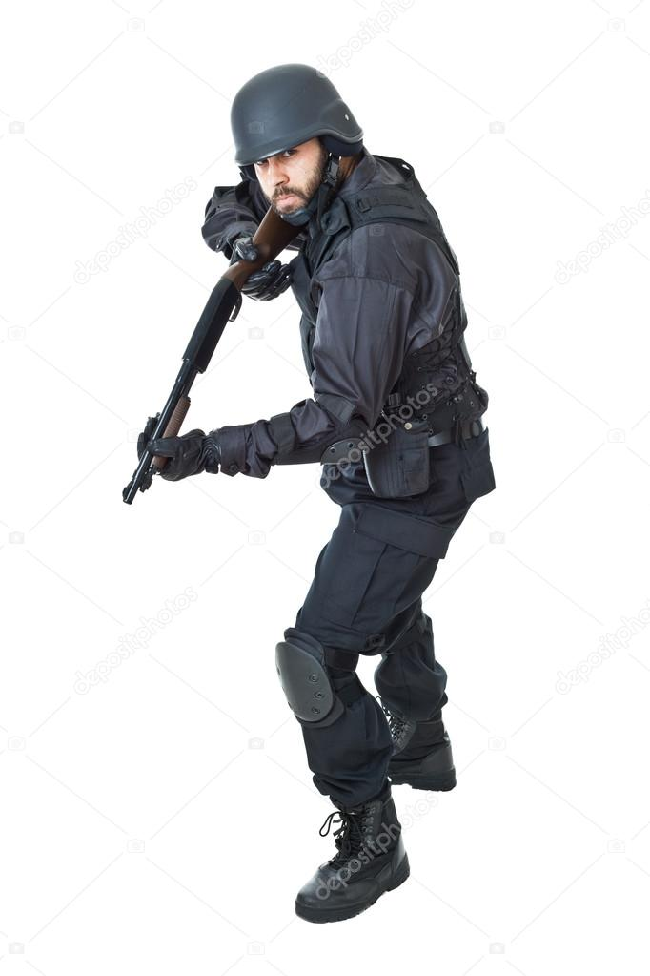
Tactical Repositioning
Body language
Body movements
Challenging posture
De-escalation Training 2020
Notes:
Tactical repositioning involves the knowledge of and use of observing and responding to environmental conditions such as body language, body movements, and challenging posture. Let's examine each of these.

Slide 25
ALAMEDA PD
Notes:
Explain better why you are there.
WHAT’S THE MISSION – to ensure this guy’s safety
Is the physical confrontation worth it? Can we let him go?
Take your time, listen more.

Slide 26
Body Language
Finger pointing | May seem accusing, threatening
Shoulder shrugging | May seem uncaring, unknowing
Rigid walk | May seem unyielding, challenging
Set jaw/clenched teeth | Indicates mind closed against listening to person’s side of the story
Quick actions | May surprise, scare other person
De-escalation Training 2020
Notes:
Proper body language is extremely important in de-escalation, making the citizen feel at ease while the officer maintains a tactically sound position.
Finger pointing may seem accusing or threatening.
Shoulder shrugging may seem uncaring or unknowing.
Rigid walking may seem unyielding or challenging.
Jaw set with clenched teeth shows you are not open- minded to listening to his/her side of the story.
Use slow and deliberate movements -- quick actions may surprise or scare the other person.
Paying attention to the gestures that a person is making can be beneficial in determining their state of mind:
Lowering the head
Pointing a finger
Hand gestures
Placing a hand on the other person’s shoulder
Gesturing with open arms and palms out
Other Examples?
Remember: the keys here are time and distance. Make sure you have the appropriate distance between yourself and the individual and slow the event down. You are not in a hurry. The other calls can wait, especially if it means not using force or deadly force.

Slide 27
Body Movements
Measured stride, shoulders back, and head erect
Slouching, head down, leaning against a building
Arms folded, legs crossed
Other examples?
De-escalation Training 2020
Notes:
Body movements can be key to determining an individual's state of mind and intentions. It is important to pay attention to their position and composure. Are they preparing to fight, or ready to flee? Whether they will be compliant or combative can often be determined by their voluntary or involuntary body movements.
Measured stride, shoulders back, and head erect
Slouching, head down, leaning against a building
Arms folded, legs crossed
Other examples?
INSTRUCTOR NOTE: How does mental illness affect body movement? People with chronic, severe and disabling mental disorders may have trouble communicating in coherent sentences or carrying on conversations with others. Their movements may be much slower, or in repeat rhythmic gestures, or they may make movements such as walking in circles or pacing. The influence of mental illness on psychomotor skills can cause a lack of coordination or control of movement that may impact the way you perceive the individual, and the way they respond to you.
Just as important is how they receive information from you. Your body movements, verbal commands, or gestures may impact their capability to comprehend what you're doing or asking. Fast or rapid movements and complicated, loud or hurried speech may confuse or sidetrack their ability to respond to you.

Slide 28
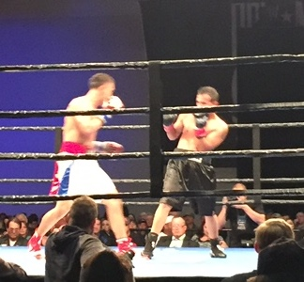
Challenging Postures
Face to face
Nose to nose
Toe to toe
Eyeball to eyeball
Touching
Finger pointing
De-escalation Training 2020
Notes:
Challenging postures that tend to threaten another person and escalate any situation include:
Face to face
Nose to nose
Toe to toe
Eyeball to eyeball
Touching
Finger pointing
Instructor Note: Officer safety is always of the utmost importance, so make sure you discuss defensive positioning.
Don’t forget your defensive positioning and defensive tactics training. While de-escalating another person, you want to be in a non-threatening, non-challenging and self-protecting position. Stay slightly more than a leg’s length away, on an angle and off to the side of the other person. Make sure that you keep your gun side back and stay far enough away that the other person cannot hit, kick or grab you.

Slide 29
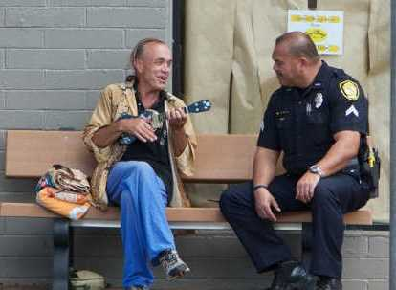
Tactic: When Safe, Seek Their Level
Physically
Emotionally
Mentally
De-escalation Training 2020
Notes:
One powerful de-escalation tactic is for officers to seek the level of the person they are de-escalating. This tactic may be considered when you are dealing with an unarmed individual who does not appear to be a threat to you or others.
This tactic can be employed in a variety of ways, depending on the situation. Remember: always retain your tactical advantage, but practice methods such as squatting down a safe distance from the subject with your gun side away. To the individual, this tactic may demonstrate sympathy or compassion, and they will never realize that you are maintaining your defensive posture.
Seek Their Level
Physically – Squat down, kneel down or bend over slightly
Emotionally – Use empathy and show understanding to validate their issue
Mentally – Speak and move slowly, being deliberate and ensuring understanding

Slide 30
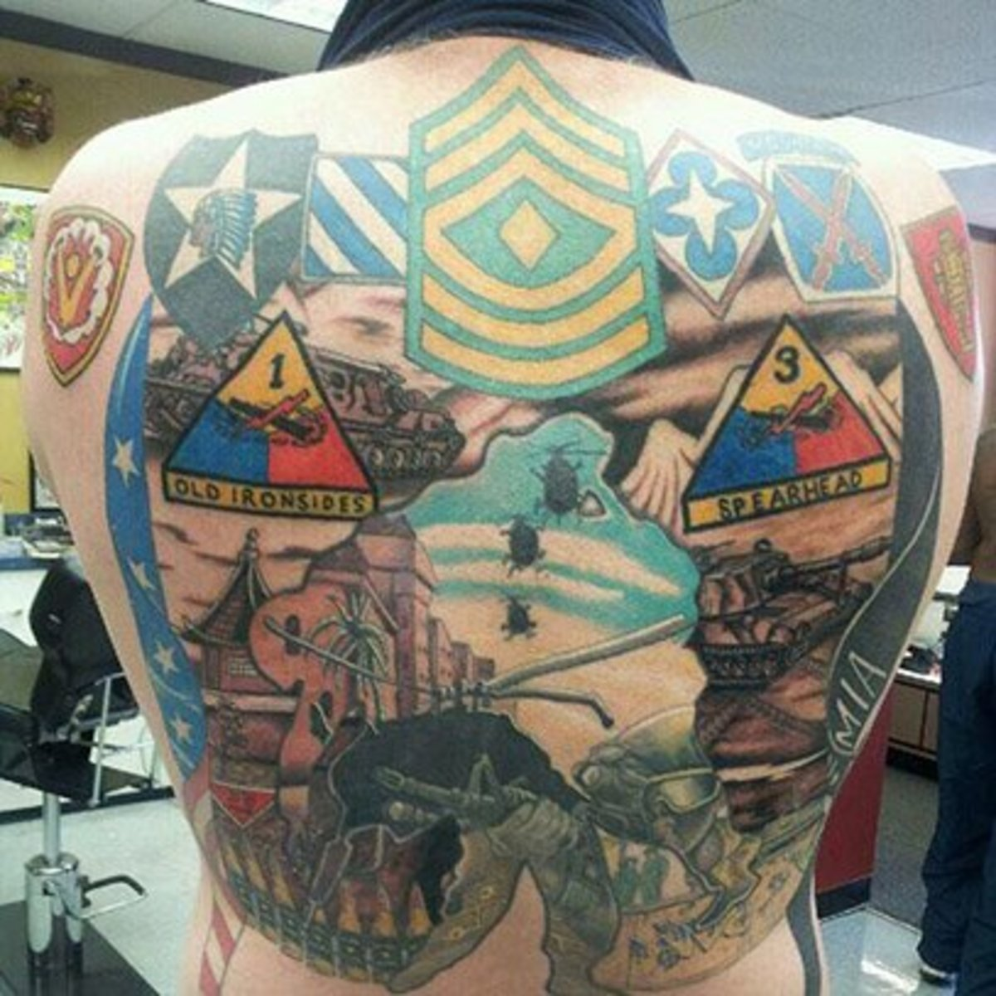
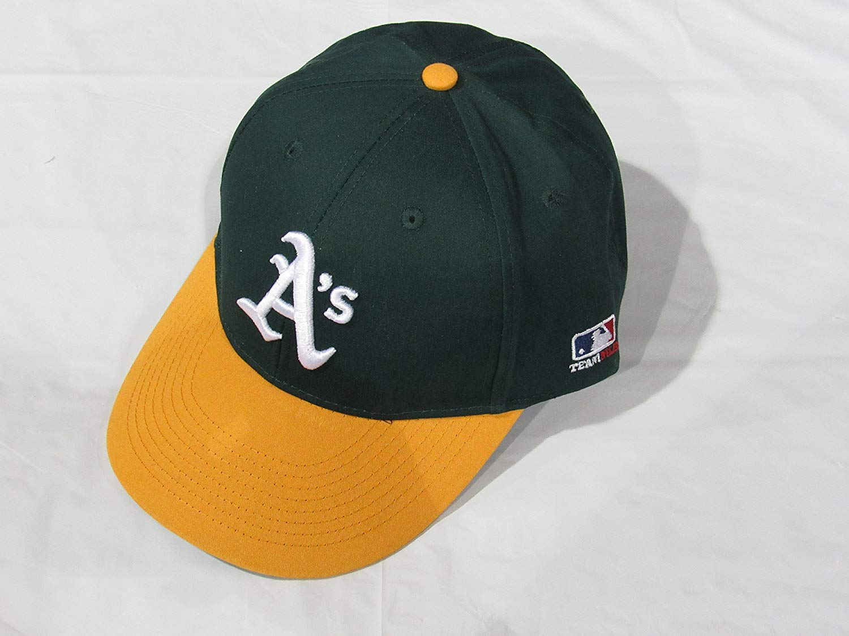
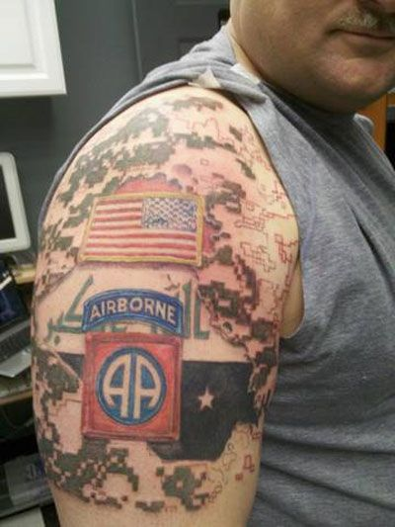
Tactic: Make a Connection
Clothing
Jewelry
Tattoos
Vehicle
House/Apartment
Surroundings
De-escalation Training 2020
Notes:
De-escalation Tactic #2 is to make a connection with the person in order to start a conversation and engage the person or as a distraction tool to calm them down.
Officers must use their observation skills to look for ways to connect with other people such as noticing:
Their clothing: styles, types, logos, words or pictures on shirts, tattoos
Jewelry: necklaces, pendants, charm bracelets
Vehicle: bumper stickers, other stickers, type of car or motorcycle
House/Apartment: signs, flags, banners, trophies
Surroundings: Parking lot, field, sporting event
Sometimes officers may need to ask about several different items before finding the one that connects with the individual and breaks down barriers to communication. One example of this was an officer responding to an attempted suicide call, and in an effort to engage the individual asked about is tattoos (was he in the military), his sneakers (did he play sports) and finally noticed the man was wearing a gold chain with a cross on it and asked him about his religion. Noting that they shared the same faith, the man then connected with the officer and within minutes they were on the way to the hospital to get him some help.

Slide 31
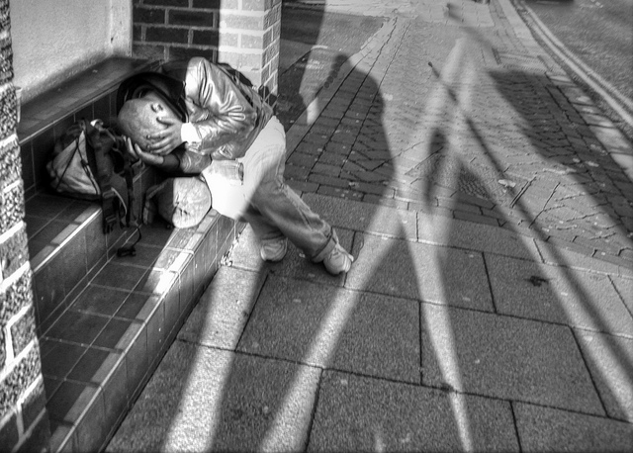
Tactic: Distract the Person
Distract by changing the topic to something calming for the subject
De-escalation Training 2020
Notes:
De-escalation Tactic #3 is to distract the person.
Officers can often distract a person calm them down and engage them in meaningful conversation by discussing another topic. This tactic differs from connection in that it is often used when the officer can find no visible signs that lead to a connection with the person, or when the person may be suffering from a mental illness.
Officers can inquire about sports teams, family members, medical treatment or medications in an attempt to distract the person from their current situation. In one situation, the officer encountered a woman on the street who seemed to be in some type of trance, just sitting and whispering to herself but not responding to questions. When the officer heard her mumbled something about a puppy, she inquired if the lady had a dog and immediately the barrier was broken down. The lady began to talk about her pet and soon agreed to a trip to the hospital without any resistance or violence.

Slide 32
Tactic: Motivate the Person
Be clear and accurate
Avoid jargon or slang
Be aware of both surface and hidden meanings
Avoid satire, sarcasm, and jokes
Use words that can be understood
De-escalation Training 2020
Notes:
De-Escalation Tactic #4 - Motivate the Person
Another popular de-escalation tactic that is often employed with distraught individuals or those contemplating suicide is motivation. Officers can motivate people by explaining how their life matters, how they impact others, and the need for them to assist their family or friends.
In one instance, an officer responded to a distraught man in a parked vehicle. The man explained that he did not want to live and that no one cared. The officer told the person that people care, people you don’t know about and gave him the example of the person who called 911 inquiring about his well-being, and that he as an officer cared to respond and spend whatever time necessary with him. Motivation worked, and the man agreed to seek help.

Slide 33
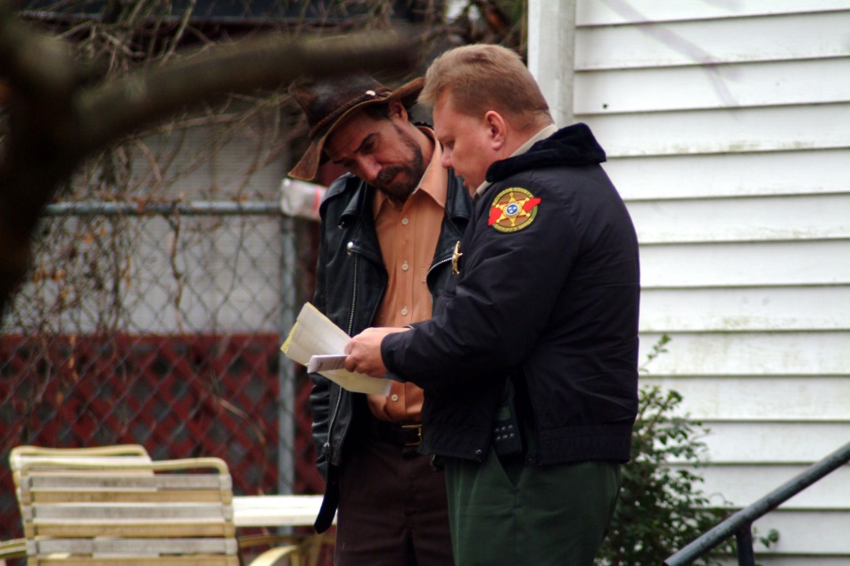
Tactic: Offer Options, Allow Acceptable Decision-Making
De-escalation Training 2020
Notes:
De-escalation Tactic #5 – Offer Options and Allow Acceptable Decision-Making
One popular de-escalation tactic often employed by hostage negotiators over the years has been to offer a series options to the individual that will allow them to make acceptable decisions.
Officers should ensure that they offer only options that are acceptable to the officer and agency. For example, if the subject has mentioned during the conversation that they want to harm themselves and the officer knows that the eventual outcome will lead to some form of hospitalization or observation, the officer should not offer an option of a non-custodial release.

Slide 34
Video Discussion: Tactics
De-escalation of man with knife
A South Daytona police officer calmly takes mentally ill man into custody
De-escalation Training 2020

Slide 35
Module 4 – De-escalation: Becoming the Norm
CA Assembly Bill 392:
Sponsored by the ACLU
Eliminates the Graham v Connor reasonableness standard
Replaces with a standard of “Necessity”
Senate Bill 230
Increases and Standardizes training
De-escalation Training 2020

Slide 36
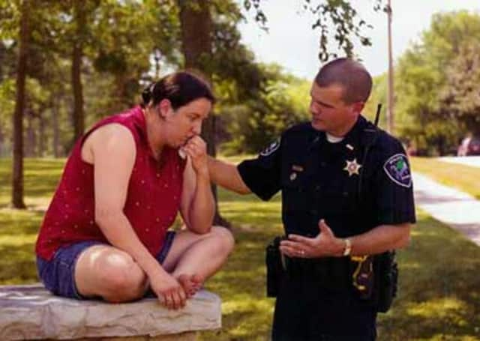
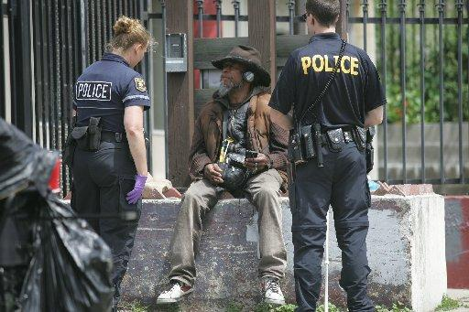
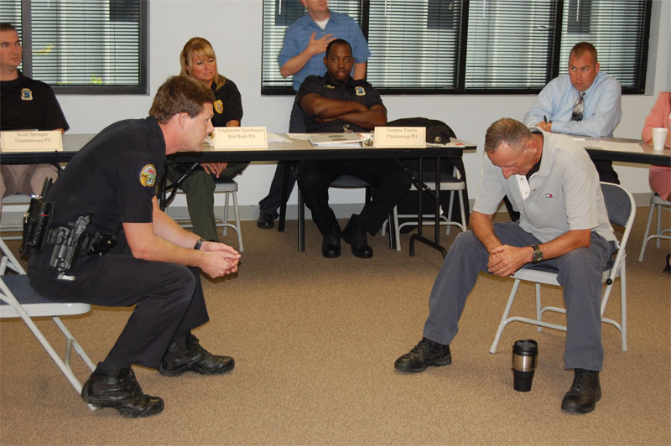
De-Escalation and Crisis Intervention
FCPD Policy 466.6 addresses De-escalation during Crisis Intervention Incidents:
“Officers should consider that taking no action or passively monitoring the situation may be the most reasonable response to a mental health crisis.”
De-escalation Training 2020

Slide 37
De-Escalation and Crisis Intervention
FCPD Policy 466.6 Continued:
Once it is determined that a situation is a mental health crisis and immediate safety concerns have been addressed, responding members should be aware of the following considerations and should generally:
Evaluate safety conditions
Introduce themselves and attempt to obtain the person’s name
Be patient, polite, calm, courteous and avoid overreacting
Speak and move slowly and in a non-threatening manner
Moderate the level of direct eye contact
De-escalation Training 2020

Slide 38
De-Escalation and Crisis Intervention
FCPD Policy 466.6 Continued:
Remove distractions or disruptive people from the area.
Demonstrate active listening skills (e.g., summarize the person’s verbal communication).
Provide for sufficient avenues of retreat or escape should the situation become volatile.
De-escalation Training 2020

Slide 39
De-Escalation and Crisis Intervention
FCPD Policy 466.6 Continued:
“Responding ﻿officers generally should not:
Use stances or tactics that can be interpreted as aggressive
Allow others to interrupt or engage the person
Corner a person who is not believed to be armed, violent or suicidal
Argue, speak with a raised voice or use threats to obtain compliance
De-escalation Training 2020

Slide 40
Video Discussion: Time and Tactics
Great Police Work/De-escalation by Officer Linda Gutierrez 03/7/2019
De-escalation Training 2020
Notes:
Great police work/de-escalation by Officer Linda Gutierrez! 3/7/19

Slide 41
Closing: 7 easy steps to successful de-escalation
Don’t be a jerk
“If you start out nice, you can always get mean, but if you start out mean, you can never be nice.”
Communicate
Be the 52-year-old you, not the 17-year-old you.
“Don’t take it personally, don't make it personal.”
Don’t hang out with angry people (internal culture)
Finally, and most importantly, de-escalation never means compromising officer safety
De-escalation Training 2020

Slide 42
Closing: Common Sense Tips
Common Sense Tips
LINK TO POST VIDEO
De-escalation Training 2020

