Slide 1






TOWN HALL MEETING
PROGRAMS & RESOURCES FOR THE RESIDENTS OF FOSTER’S LANDING
APRIL 26, 2021

Slide 2
Welcome & Introductions
Nicole Conrad, Essex Properties
Norma Arinaga, Essex Properties
Alicia Williams, Essex Properties
Inas Elmashni Atawneh, HIF
Amanda Edwards, HIF
La Trice Taylor, Samaritan House
Chris Sturken, HIP Housing
Ginny Marans, St. Vincent de Paul
Leslie Carmichael, Foster City/UPP
Marlene Subhashini, Foster City
Monica Ly, Foster City
Notes:
Welcome everyone, This meeting is being recorded. My name is Monica Ly and I am the Assistant Planner with the City of Foster City. Thank you everyone for taking the time to join us for this Town Hall Meeting to discuss some of the programs and resources available to you. Before we dive in I would like to introduce all of you to our Partners and fellow staff members. Here we have:
Nicole
Norma
Alicia, Essex Properties
Inas
Amanda, The Housing Industry Foundation
La Trice, Samaritan House
Chris, HIP Housing
Ginny, St. Vincent de Paul
Leslie ,
Marlene, Foster City

Slide 3


Zoom Meeting Instructions
Raise Hand : Raise your hand in the webinar to indicate that you need something from the host and lower your hands once you’ve been assisted.
Question & Answer : Open the Q&A window, allowing you to ask questions to the host and panelists. They can either reply back to you via text in the Q&A window or answer your question live.
Notes:
All attendees will be muted until the Q&A session. If you need something from us just raise your hands and lower them once you’ve been assisted. You may ask questions in the Q&A window however we ask that you save your questions until the Q&A session.

Slide 4
Efforts to Date
Met with numerous public officials and representatives from various organizations to seek funding, support, and assistance including:
Jacqueline Speier’s Office
Housing and Urban Development (HUD)
HIP Housing
Housing and Community Development
San Francisco Mayor’s Office of Housing
Google
Facebook
KH Equities
California Apartment Association
Housing Accelerator Fund
All Home
Enterprise Community Partners
AutoTemp Services
Palo Alto Housing
CROWN
Associated Right of Way Services
Overland Pacific and Culture
Samaritan House
St. Vincent De Paul of SMC
Life Moves
Coast Side Hope
Brilliant Corners
Abode Services
California Housing Partnership
Notes:
The Expiration of the Affordable Housing Covenant has been and remains a top priority to our City and Essex. Staff, the Sustainability Subcommittee, the Council, the Planning Commission, and our partners have dedicated countless hours to address this very important issue. We met with numerous public officials and representatives from various organizations to seek funding, support, and assistance including all the organizations listed here and more. I cannot stress enough how committed we are to serving you during these tough times.

Slide 5

We Heard You
Feedback from Residents | Program | Description | Status
Various residents: Difficult to get on waitlist. | At-risk Tenants Preference Category Program | The City Council adopted a Resolution (2020-24) to place tenants at-risk of displacement due to termination of affordability restrictions at the top tier (1a) of the affordable housing preference category | Approved 3/18/2020
Angela requested to extend the affordability due to COVID-19 Corine said she needed more time to find housing for her mom and brother | Post BMR Expiration Agreement | Essex and the City agreed to allocate $800,000 (split 50/50) to provide rental subsidies and preserve the affordability of the Phase I Units to December 31, 2021. | Approved 9/28/2020
Venessa said that: the top need is financial – don’t have first and last month’s rent or transportation | Early Relocation Assistance Program | The Early Relocation Assistance Program aims to provide the residents of Foster’s Landing Below Market Rate Program with financial assistance to off-set the up-front cost associated with relocating and enable the residents in finding replacement housing. | Approved 2/1/2021
Notes:
We heard you and shown here are just some of the programs we adopted to meet your needs. One of our primary goals was to help Foster’s Landing residents remain in Foster City and so we adopted the “At-risk Tenants Preference Category Program.” This Program places any Foster’s Landing resident in the BMR program in the top tier of all the affordable housing waitlists in Foster City as long as they apply to get on the waiting list.
Last year in June the City held a Town Hall Meeting to Listen to the residents of Foster’s Landing and we heard you. Highlighted here is some of the feedback we received from the residents. Angela requested to extend the affordability of the units due to COVID-19. Corine said she needed more time to find housing for her mom and brother. Many of residents requested to extend. And so, Essex and the City agreed to allocate $800,000 (split 50/50) to provide rental subsidies and preserve the affordability of the Phase I Units until December 31, 2021.
Venessa and a number of other residents said that: the top need is financial – don’t have first and last month’s rent or transportation. We heard you. Essex and the City established The Early Relocation Assistance Program which aims to provide the residents of Foster’s Landing Below Market Rate Program with financial assistance to off-set the up-front cost associated with relocating and enable the residents in finding replacement housing.

Slide 6
Early Relocation Assistance Program (ERAP)
Reimburse the former residents of Foster’s Landing for relocation costs due to displacement.
Minimize the impacts of displacement by assisting tenants with move-out costs, rent deposits, application fees, etc.
Enable current Foster’s Landing residents to relocate early by offsetting the upfront costs associated with moving
Notes:
This program Reimburse the former residents of Foster’s Landing for relocation costs due to displacement.
Minimize the impacts of displacement by assisting tenants with move-out costs, rent deposits, application fees, etc.
Enable current Foster’s Landing residents to relocate early by offsetting the upfront costs associated with moving

Slide 7

Apply Now
Relocation Assistance Money is based upon each households’ rent differential (difference between tenant paid rent and market rent with a $10,000 cap for some Phases)
The longer a household remains in their unit the less money they will be eligible to receive
Please contact Amanda Edwards, Program and Development Manager at HIF: amanda@hifinfo.org | (650) 246-4517
Notes:
The Relocation Assistance Money allocated for each resident is based upon each households’ rent differential which is the difference between tenant paid rent and market rent) with a $10,000 cap for some Phases.
The longer a household remains in their unit the less money they will be eligible to receive.
With that, I’d like to turn it over to Amanda, the Program Manager at the Housing Industry Foundation, who will be administering the Early Relocation Assistance Program and is here to discuss the Application Process. Thank you.

Slide 8

Early Relocation Assistance Program
Notes:
Quick intro re: HIF, who we are, where located
Stats to hit: 30 yrs in Santa Clara and San Mateo, holistic approach to keeping people housed

Slide 9



HIF Programs
Emergency Housing Fund
Affordable Housing Initiative
Renovation Program
Helping to prevent homelessness
Emergency grants of up to $2500 for people who have fallen behind on rent to prevent eviction.
Supporting community workers with affordable housing
Pairs community-focused workers with affordable housing options
Improving facilities and services for shelters
Building program that helps renovate shelters to provide dignified and stable housing for all
Notes:
During pandemic our programs have focussed on homelessness prevention--we have been issuing emergency grants to cover back rent and renovating shelters to support re-homing efforts.
-The Emergency Housing Fund works as a stop-gap to keep people housed when they fall behind on rent. Community members apply directly to HIF for grants of up to $2500 that can be applied towards rent, security deposit or utilities. HIF to date has invested $8 million dollars and served over 21,000 individuals
- The Renovation Program provides shelter renovations to community based groups/non-profits serving at risk individuals and families.
- This allows shelters to focus on providing services and care to get people back on their feet.
- Renovation processes can be labor and time intense, and often cause shelter closure while they are planned and implemented. By taking the burden of both the planning and work off their hands, the renovation program ensures that shelters can stay open as long as possible and serve as many individuals as need support.
- To date we have renovated over 100 shelters and non-profits
Through this work, we’ve found that the key to preventing these issues is providing affordable housing to those who support our communities
AHI is a capstone program designed to prevent people falling into debt or becoming homeless by providing affordable housing from the start, with a focus on those who support community function.
Designed this way because of the current affordable housing crisis

Slide 10
ERAP Application
Step-by-Step Instructions
HIF requires the following documentation to approve your application:
1) A completed online application
2) Copy of photo ID (only needed for main person listed on rental agreement)
3) Foster’s Landing rental agreement
4) New rental agreement
5) Copies of all receipts associated with relocation expenses
6) Completed W-9 form (if expenses paid directly to you total over $600)
Copies of your receipts can include the following:
1) Moving Expenses (Receipts for any expenses associated with moving your household items. Examples of these include the cost of packing, crating, renting a trailer, hiring movers, etc.)
2) Travel Expenses (Receipts for travel expenses from your old home to your new one. Examples of these include car expenses, airfare, etc.)
3) Storage Expenses (Receipts for expenses associated with storing household items. These expenses must occur within any period of 30 consecutive days after your belongings were moved from your former home and before they were delivered to your new one.)
4) Security Deposit for your new home

Slide 11

Timeline
Upon submission of a complete application, HIF will process your claim within 1 week
The City of Foster City issues checks the 2nd and 4th week of each month​

Slide 12
ERAP Application Link
Click here!

Slide 13
For more information, please visit:
www.hifinfo.org
Amanda Edwards
Program and Development Manager
amanda@hifinfo.org
Inas Elmashni-Atawneh
Housing Programs Director
inas@HIFinfo.org
Notes:
Survey link in email post event

Slide 14

Samaritan House
Fighting Poverty. Lifting Lives.
April 26, 2021

Slide 15
Samaritan House
Mission: To improve lives, promote self-sufficiency, and preserve dignity

Slide 16

The names by which you know our Samaritan House Programs
Safe Harbor Shelter & Coordinated Entry
Free Medical & Dental Clinics
Food Services
Client Services & Financial Empowerment
Kids Closet & Wee Care
Worker Resource Center
Holiday Program

Slide 17

Need Help? Need Information?
Call Samaritan House at 650-347-3648 and leave a message. Calls are returned within one business day.
To Apply –
  Visit us online at www.samaritanhousesanmateo.org and complete the application.
  Email us at info@samaritanhousesanmateo.org for an application via mail or email.
  Visit our offices at 4031 Pacific Blvd, San Mateo CA or 1852 Bay Road, E. Palo Alto, CA to pick up an application.

Slide 18
Samaritan House
CA COVID-19 Rent Relief Now Available
If you have experienced a financial hardship due to COVID-19;
If you have past due rent or utilities; and
If you have a household income that is not more than 80% of the Area Median Income (AMI)…

Slide 19
Samaritan House
CA COVID-19 Rent Relief Now Available
You may be eligible to receive help from the State of California by applying directly to Local Initiatives Support Corporation, also known as LISC.
Renters and Landlords can verify eligibility immediately by visiting HousingIsKey.com or calling 833-430-2122.
Samaritan House is one of several local partners to assist with applying for state funds.
For HousingIsKey.com help only, please call us at
650-798-4820

Slide 20

Home Sharing, Self-Sufficiency, and Property Development
Chris Sturken, Community Outreach Specialist
Notes:
Intro self, provide overview

Slide 21
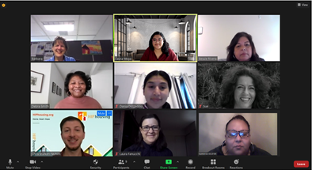
We’re Here for You

Slide 22

Housing Opportunities
    Home Sharing Program (650 people)
    Self Sufficiency Program for Families with Children (100 people)
    Property Development (28 properties/438 units)
    1,400 people housed annually
    Informational & referral calls (3,000/year)

Slide 23
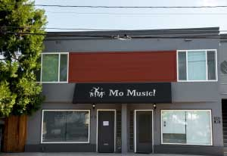
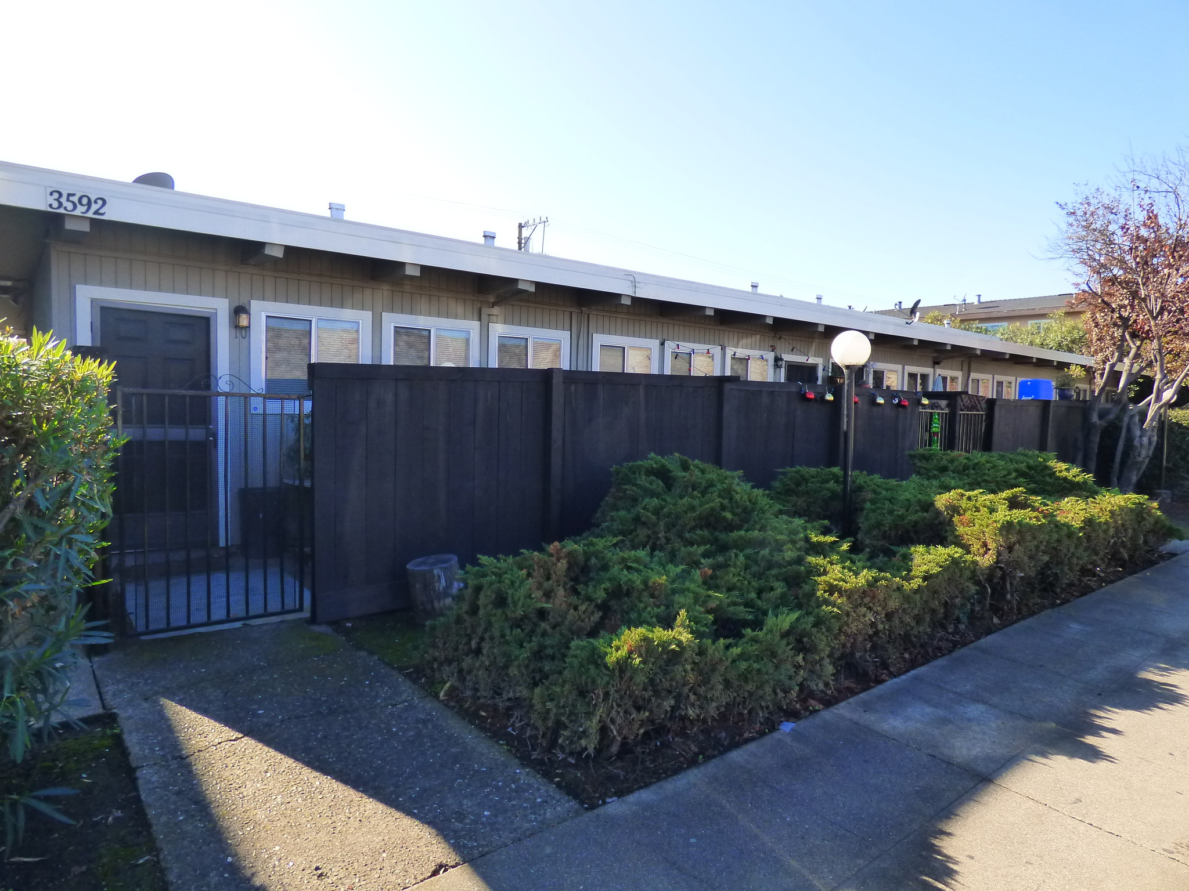
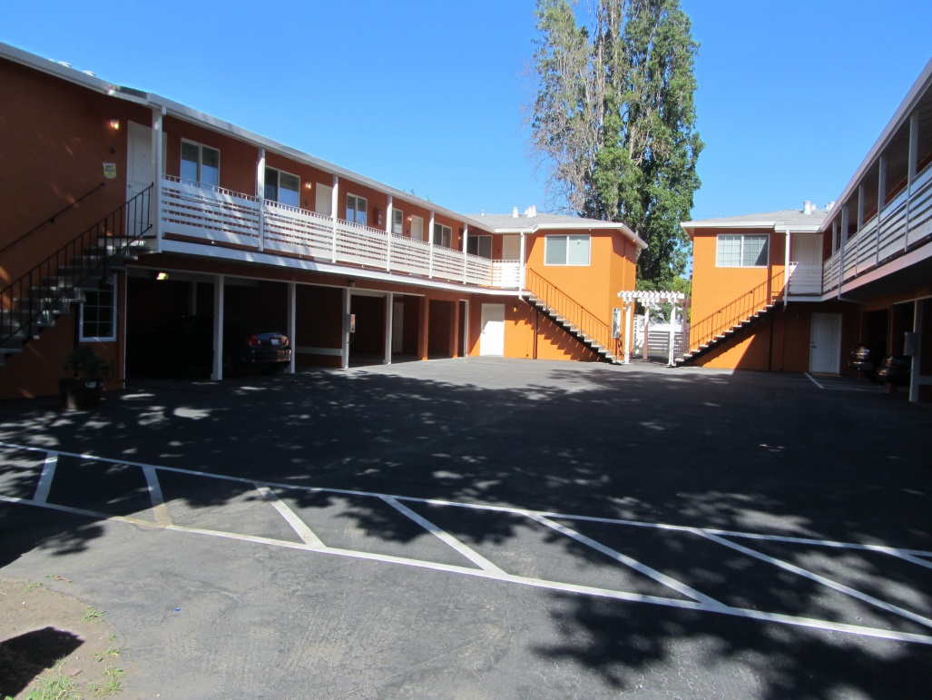
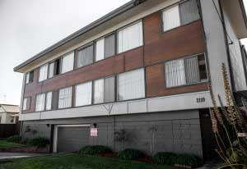

Stafford, Redwood City
(1 unit)
Rolison Rd, Redwood City (1 unit)
Willow Rd., Menlo Park (2 units)
Cypress, San Mateo (3 units)
Redwood Oaks, RWC

Slide 24


Property Development
HIP Housing Development Corporation (HHDC)
438 units
18 BMR properties
8 Section 8 properties
Call 650-348-6820
South Main Mixed Use Project, 39 units

Slide 25
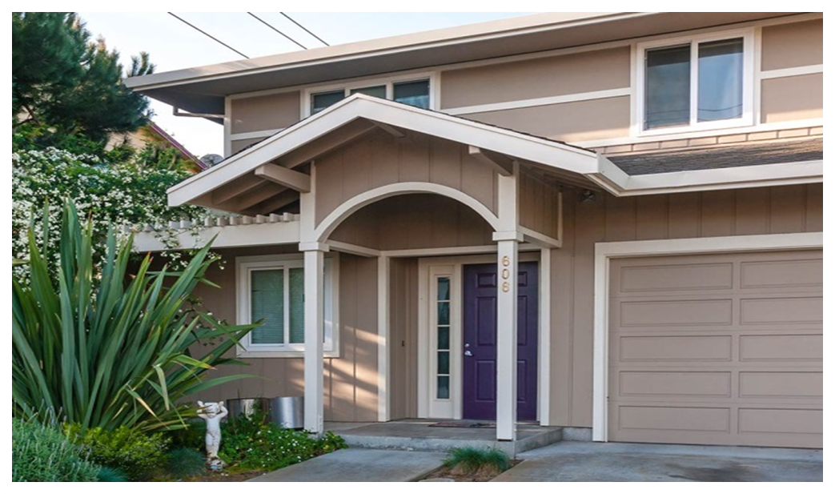

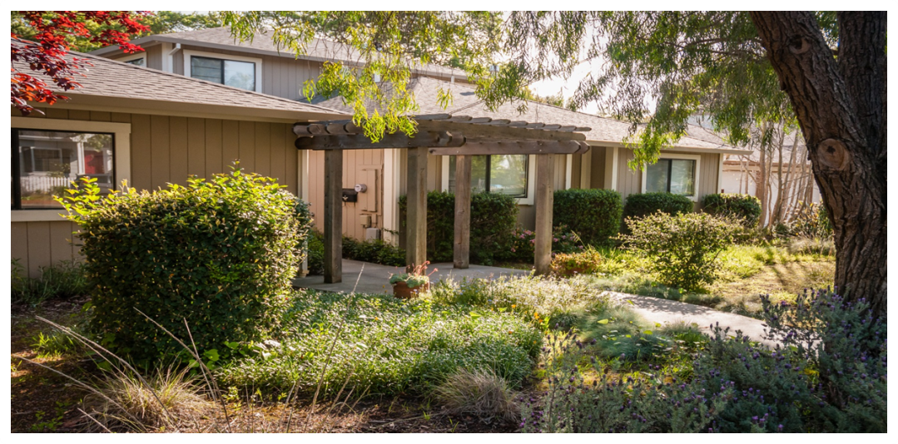
Self Sufficiency Program
Families with children
In school/job training
Housing scholarship
Case management
Life skill workshops
Can work in the US, DACA
Notes:
Includes grandparents raising grandchildren and adults who have a parent living with them.

Slide 26

Self-Sufficiency Program (Cont.)
Complete Education Plan
Financial Education
Trauma Informed Care
Bank Accounts
Savings increase/Debt reduction
Income increase

Slide 27

Home Sharing Program
Renting a room or second unit
Long term living arrangement
Live, work, or attend school in SMC
1-2 people
No citizenship requirement
Notes:
In a study by AARP, 80% of seniors want to age in place.

Slide 28

Home Sharing Program (Cont.)
Virtual appointment
Background Search
Income verification
Referrals & Resources
Living Together Agreements
Follow up support/mediation

Slide 29

Program Demographics
Home Providers Matched:
68% seniors
78% single female
Average Income $56,335
Average rent $1,077
41% of income on housing
Home Seekers Matched:
23% seniors
58% single female
Average Income: $43,570
56% homeless/at risk
29% of income on housing

Slide 30
Apply Today!
Visit hiphousing.org
Call (650) 348 6660
Mention City of Foster City
Chris Sturken
csturken@hiphousing.org
(650) 348 6660 x349

Slide 31


Slide 32


Slide 33


Slide 34


Slide 35


Slide 36


Slide 37

QUESTIONS?

