Slide 1
City of Foster City
Draft Maps
November 4, 2024

Slide 2
Agenda
Things we will cover:
Traditional Districting/Redistricting Principles
Public Testimony
Draft Maps
Public Hearing Schedule
What’s Next

Slide 3
Required Districting Criteria
Traditional redistricting principles used throughout the country and written into state law
There are a number of criteria that are required under the FAIR MAPS Act (ranked):
Relatively equal size - people, not citizens
Contiguous – districts should not hop/jump
Maintain “communities of interest”
Easily identifiable and understandable lines,
following natural, and man-made boundaries
Keep districts compact – appearance/function

Slide 4
Submitted Testimony
13 Communities of Interest Submissions
Four people submitted testimony requesting to not transition to districted elections
Encourages the City Council to base criteria on three things: 1. geographic proximity; 2. dwelling type; 3. traffic and noise
HOA consideration
School boundary consideration
Renters
Lagoon homes (multiple submissions)
Elementary School communities
SAMCAR / Realtor MLS Market Areas
Notes:
Will be converted to GIS files so you will be able to view these maps on DistrictR
No matter how you decide to submit you COI, all work received in preserved by the city

Slide 5
Submitted Testimony
Publicly Submitted Maps
16 Districtr maps were submitted prior to the 7-day posting deadline
Districted maps submitted after this deadline will be discussed at the November 18th meeting
1 hand-drawn map
All maps are up for discussion and can be uplifted as official draft maps at the discretion of the City Council
Notes:
Will be converted to GIS files so you will be able to view these maps on DistrictR
No matter how you decide to submit you COI, all work received in preserved by the city

Slide 6
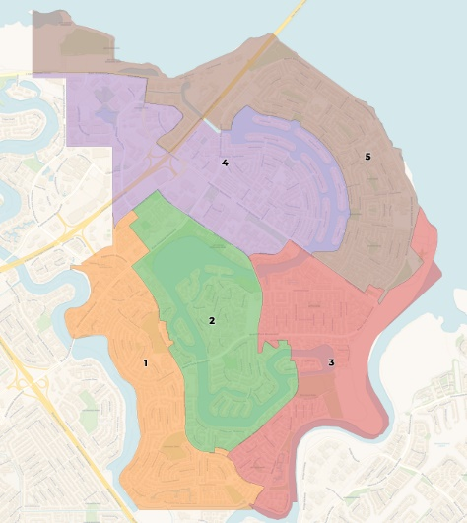
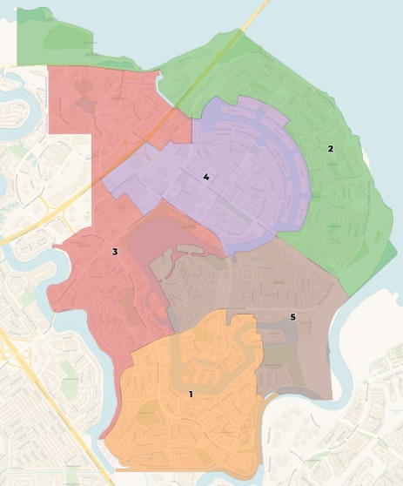
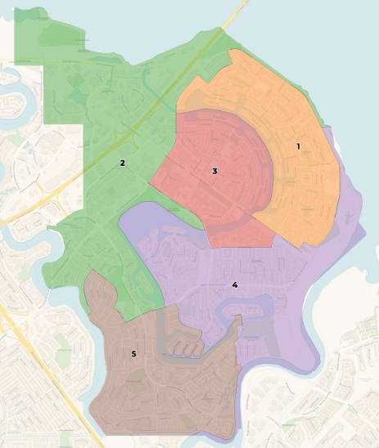
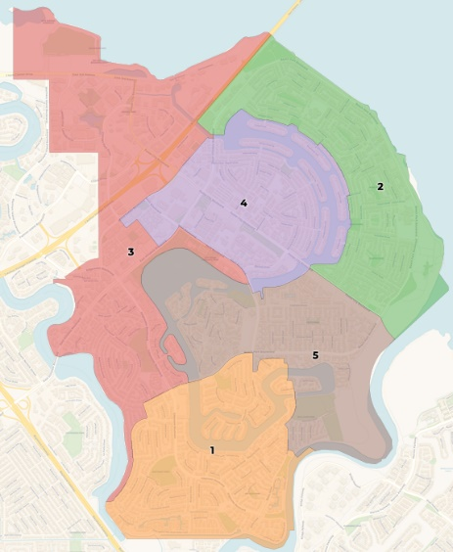
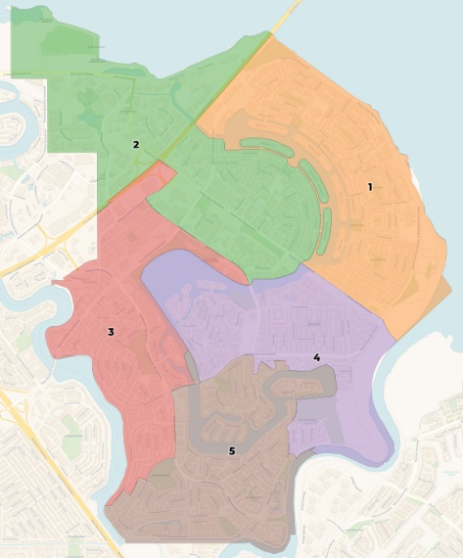
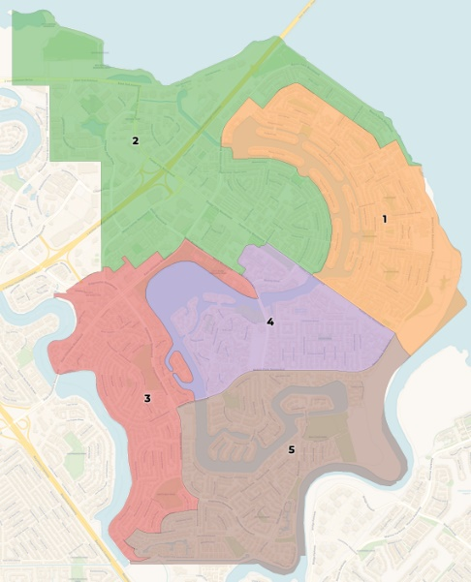
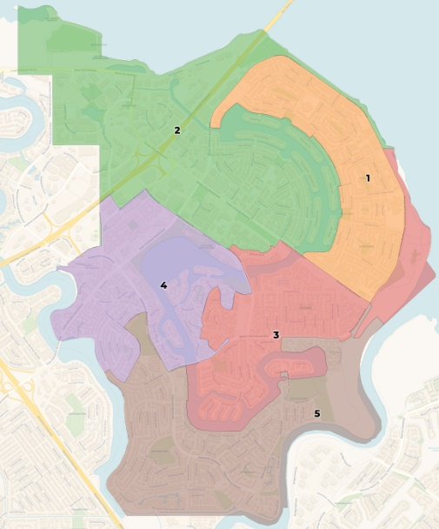
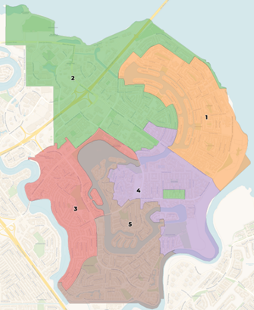
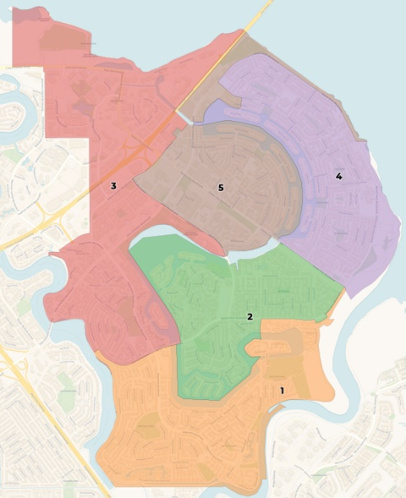
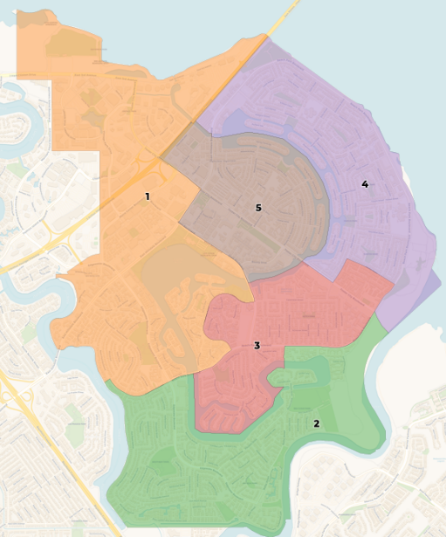
Themes in Public Maps: Central District
Notes:
Will be converted to GIS files so you will be able to view these maps on DistrictR
No matter how you decide to submit you COI, all work received in preserved by the city

Slide 7
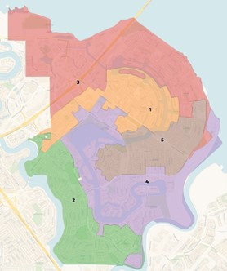
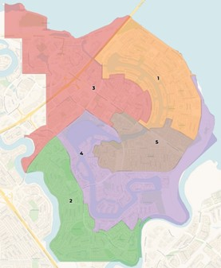
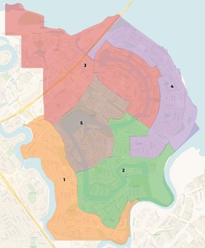
Themes in Public Maps: Eastern District
Notes:
Will be converted to GIS files so you will be able to view these maps on DistrictR
No matter how you decide to submit you COI, all work received in preserved by the city

Slide 8
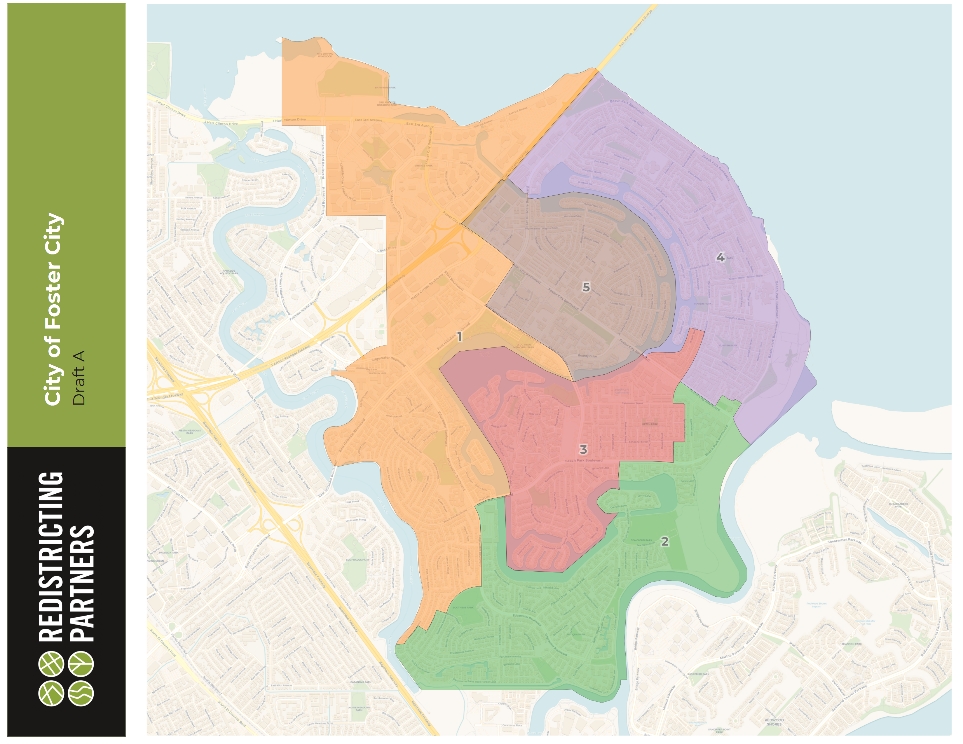
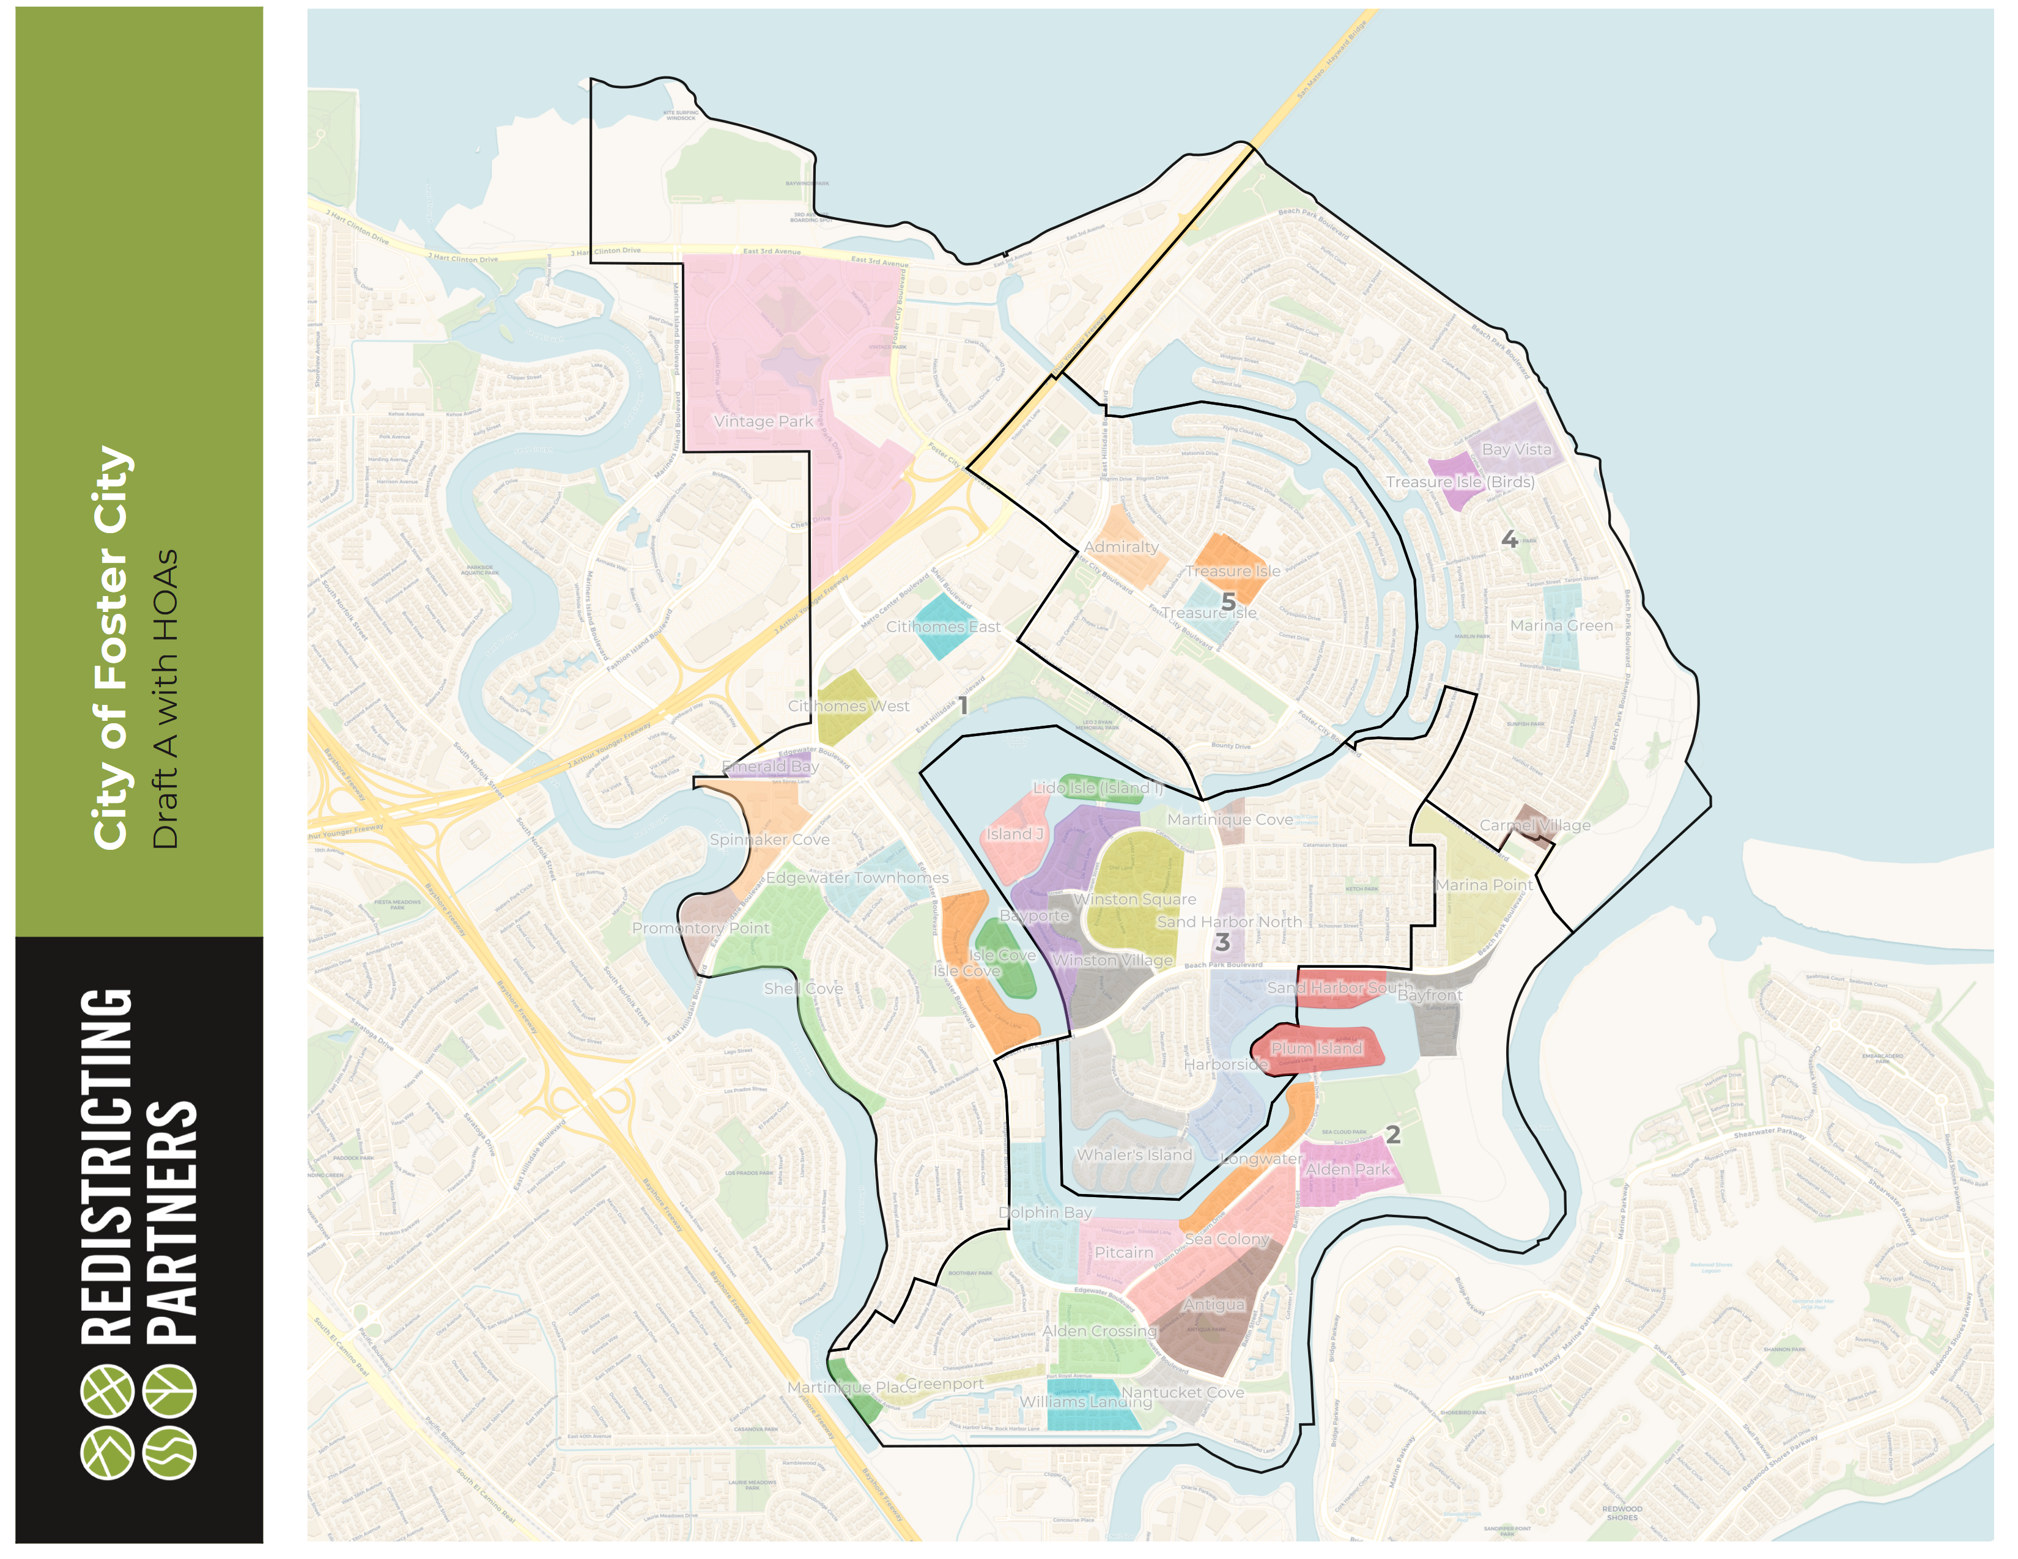
Draft Maps: Draft A
Total Population Deviation: 3.3%
Draft Map A was drawn to ensure HOAs and elementary school areas were kept intact as much as possible.
Maintains a central and eastern district
Notes:
Will be converted to GIS files so you will be able to view these maps on DistrictR
No matter how you decide to submit you COI, all work received in preserved by the city

Slide 9
Redistricting Partners
Notes:
Sophiac

Slide 10
Redistricting Partners
Notes:
Sophiac

Slide 11
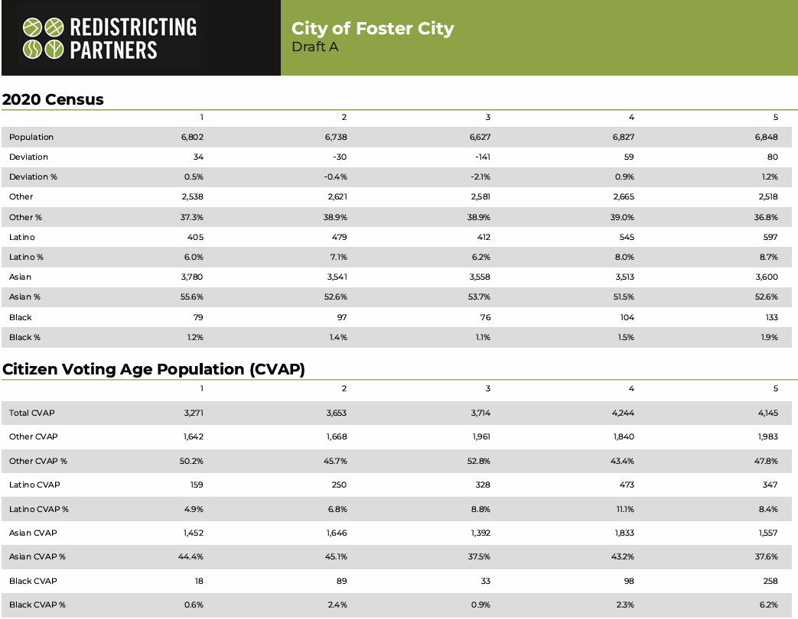
Redistricting Partners
Notes:
Sophiac

Slide 12
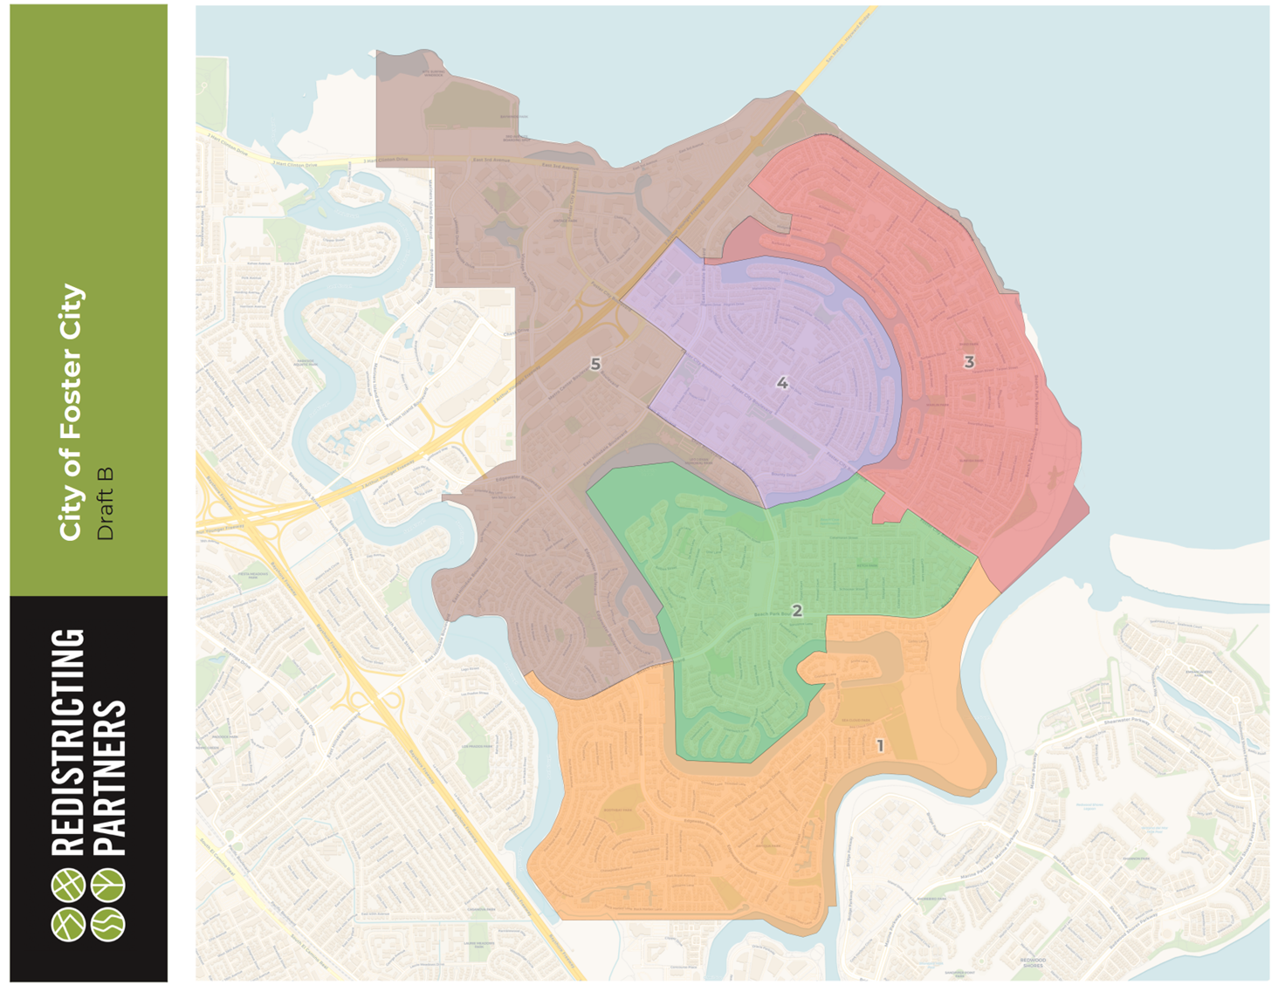
Draft Maps: Draft B
Total Population Deviation: 7.3%
Inspired by Public Map 1 and drawn in a way that balanced that public map while maintaining HOAs, when possible.
Shell Cove is the only HOA split
Maintains a central and eastern district.
Notes:
Will be converted to GIS files so you will be able to view these maps on DistrictR
No matter how you decide to submit you COI, all work received in preserved by the city

Slide 13
Redistricting Partners

Slide 14
Redistricting Partners

Slide 15
Redistricting Partners

Slide 16
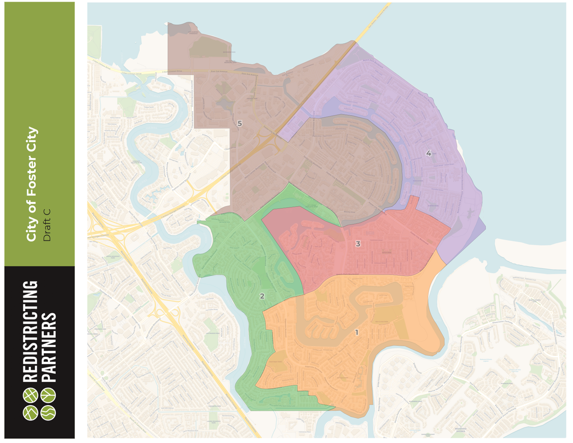
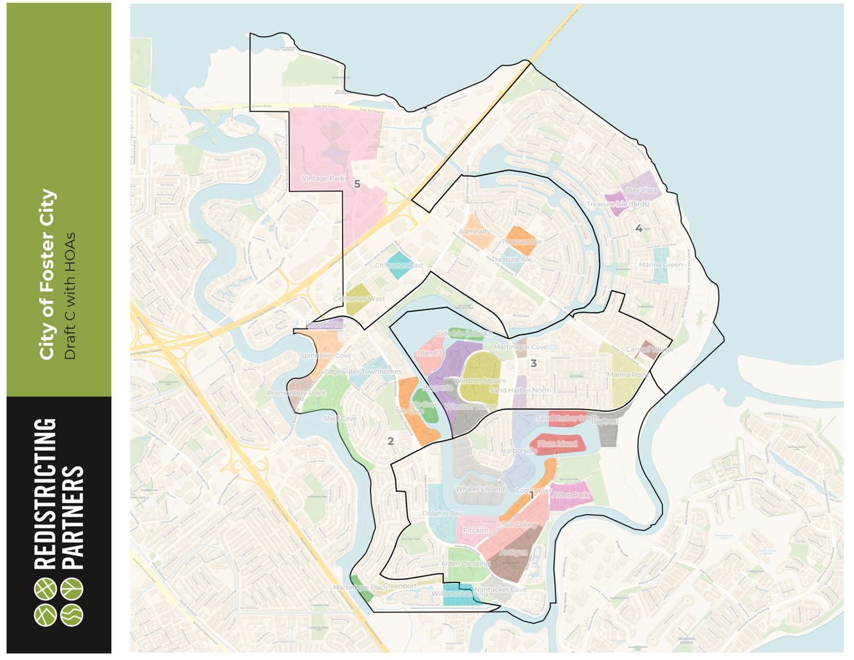
Draft Maps: Draft C
Total Population Deviation: 7.9%
Maintains a central and eastern district.
Provides a different ration of the splits on the western portion of the city while maintaining HOAs and using main roads.
Uses Beach Park Blvd as a divider
Notes:
Will be converted to GIS files so you will be able to view these maps on DistrictR
No matter how you decide to submit you COI, all work received in preserved by the city

Slide 17
Redistricting Partners

Slide 18
Redistricting Partners

Slide 19
Redistricting Partners

Slide 20
City of Foster City
First two public hearings devoted to community of interest testimony gathering and education on districting process
Public Hearings and Workshops:
October 7, 2024 First public hearing
October 20, 2024 Community Workshop
October 21, 2024 Second public hearing
November 4, 2024 Third public hearing (first maps hearing)
November 13, 2024 Community Workshop (Post-Maps)
November 18, 2024 Fourth public hearing
December 2, 2024 Fifth public hearing (final vote)

Slide 21
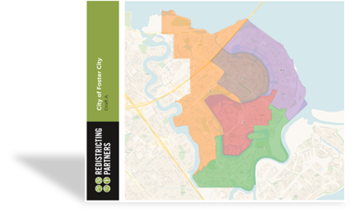
What’s Next
The City Council can make use of these mapping options in a number of ways.
Identify preferred plan(s)
To use as a jumping-off point with an understanding that none of these are final plans. It is an iterative process.
Suggest possible changes
Adjustments can be made to any of these draft plans or public maps.
Provide direction for new maps
Demographers will prepare maps with your directions for the next scheduled meeting.

